Slide 1
Living Data Workshop 1
Link to pdf of slideshow: https://bit.ly/2XJTqRl
Notes:
1 minute
Encourage students to download PDF version/google drive version

Slide 2
In this workshop...
Processing
- Recap The Coding Train material;
- Recap worksheet material (basic shapes, colour, variables etc.);
- Build example described in the prework from scratch.
Notes:
2 minutes (0:3)

Slide 3
Getting Processing
Download app http://processing.org/download (you don’t have to donate)
Follow installation instructions from the Worksheet (take extra care on Windows)
Notes:
1 minute (0:47)

Slide 4
The Coding Train recap
Drawing with Pixels
Computer graphics coordinate system (0, 0 at top left)
2D Primitive shapes (line, ellipse, rect)
How to Use Processing
Syntax
Recovering from errors
RGB Colo(u)r
Representing colour as an RGB code
stroke
fill
Notes:
5 minutes (0:48)
Switch to processing to quickly show examples.
Variables (declare/assign, also variable types) Functions (parameters) Combine variables and functions Setup/draw blocks (what they do) Do something like moving a circle across the screen to combine all so far. If statements (what they do) If variable is greater than screen width, move circle back to the other side

Slide 5
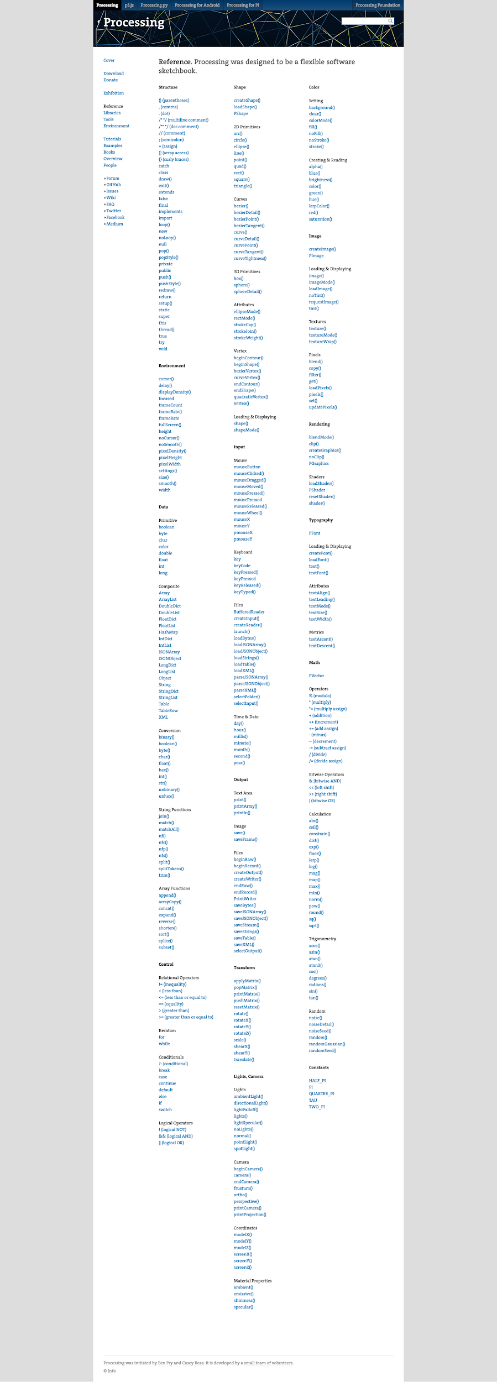
Processing Reference (https://processing.org/reference/)

Slide 6
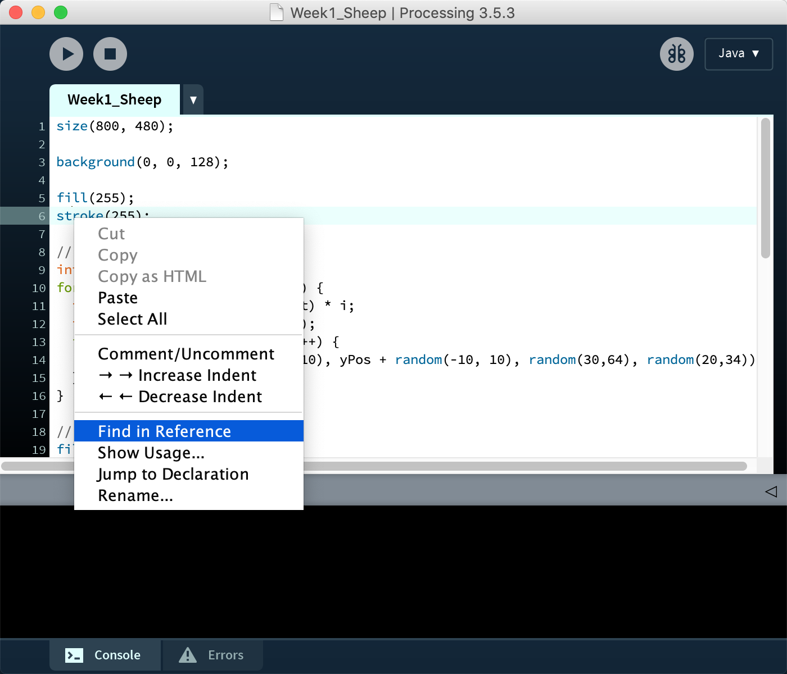
Reference is also built-in
To look up how a function works, right-click (Ctrl+Click on Mac) on it, then select “Find in Reference”

Slide 7
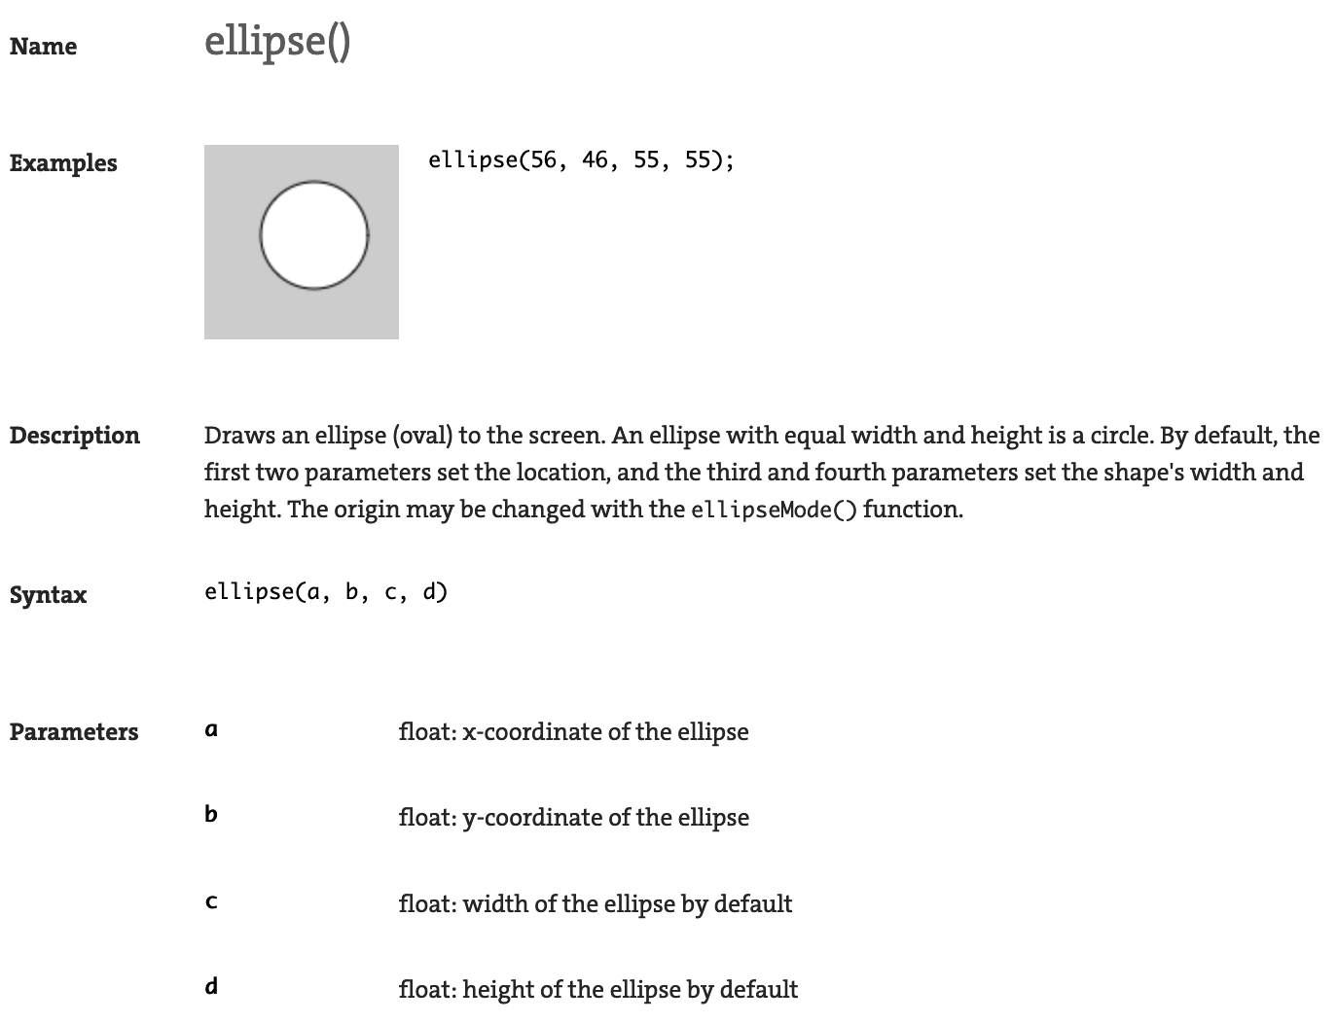
Ellipse
// Wider than it is tall
ellipse(50, 50, 100, 50)
// Taller than it is wide
ellipse(50, 50, 50, 100)
// Moved to the bottom right
ellipse(250, 250, 50, 50)

Slide 8
Checkpoint 1
Everyone should:
Have Processing installed and working
Know where to find help documentation
Be able to draw a circle!

Slide 9
Maths
One thing computers are really good at is doing maths - really, really fast.
The representation of basic arithmetic might be a little different than what you’re used to:
Addition: + Subtraction: -
Multiplication: * Division: /
Check the Reference for more operations.

Slide 10
Variables
Variables let us store a value into the computer’s memory, so that we can manipulate it or retrieve it later.
int x = 1;
x = x + 1;
println(x);
Create a new variable called x, and assign it the value of 1
Retrieve the value of x from memory, add one to it, then store it back into x again. (The RHS is run before trying to fill the variable).
Retrieve the value of x from memory, and show it on screen.

Slide 11
Variables
You can use variables together with other variables:
int xPos = (width / 2) * i;
Create a new variable called xPos, and assign it a value by doing a calculation using two other (previously created variables).

Slide 12
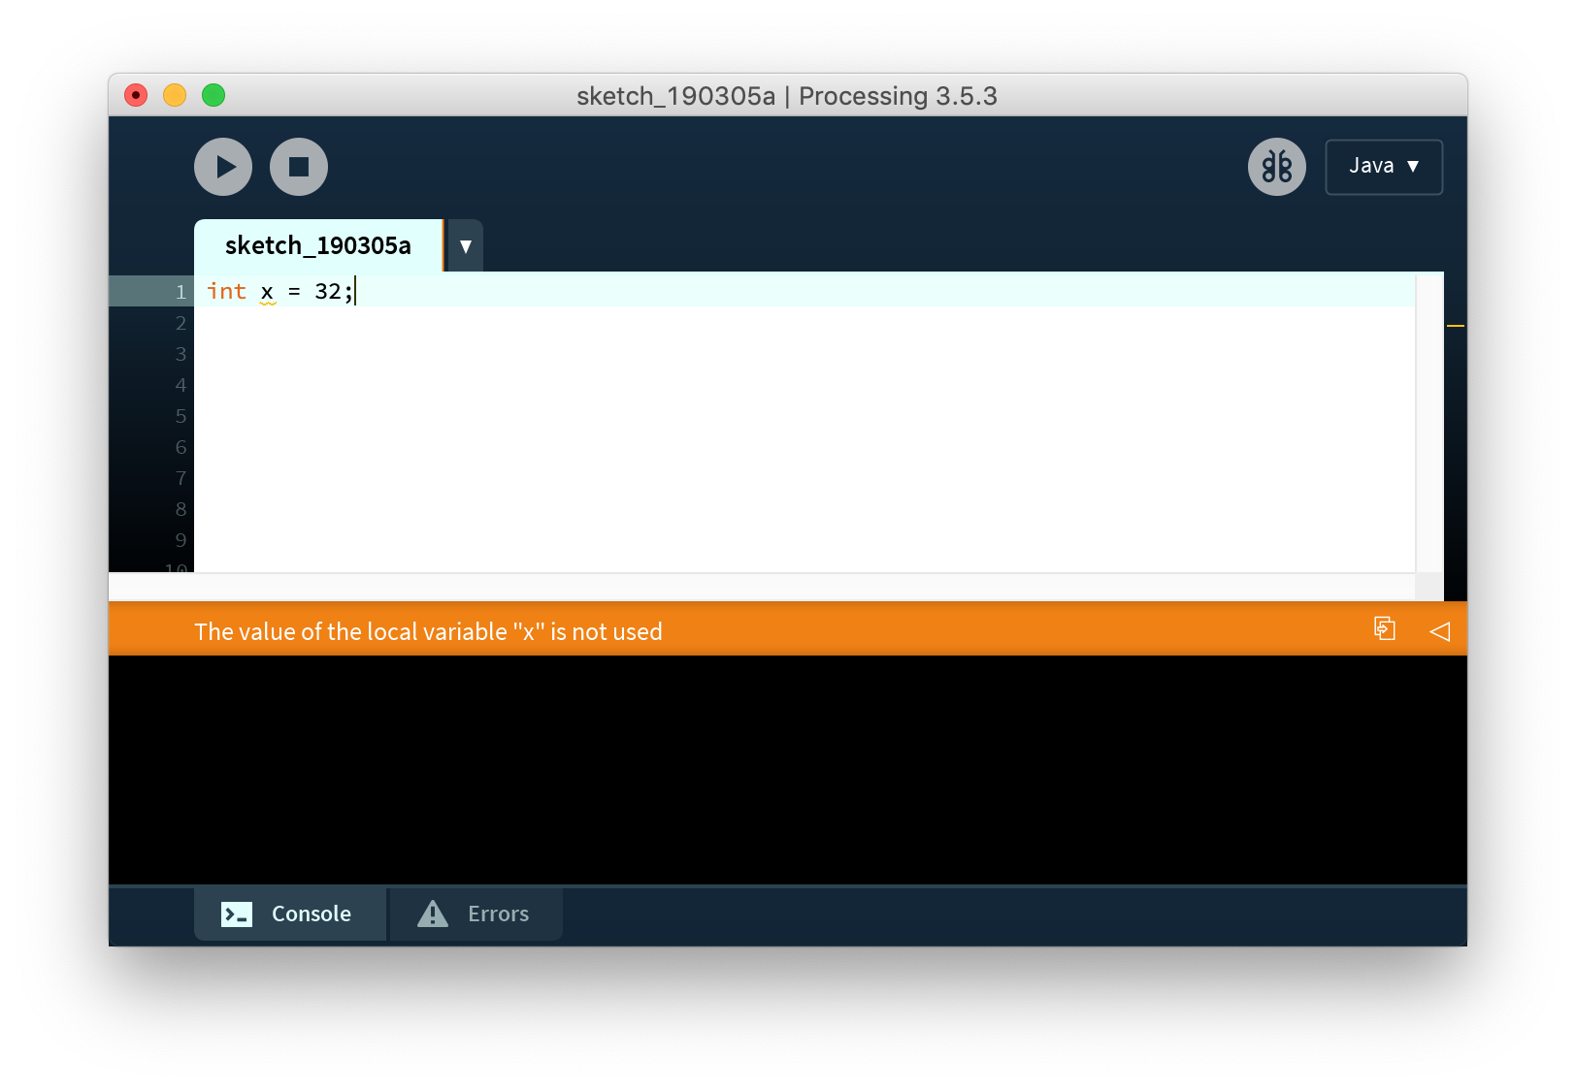
Variable Gotchas
Sometimes you will see Processing put a squiggly underline beneath a variable in orange. A message at the bottom of the window will say:
The value of the local variable “x” is not used.
This isn’t an error! Processing is pointing out that you have created a variable, but then don’t use it anywhere. You might:
Still be writing some code - just keep going
Have rewritten some code and no-longer use it - decide whether to keep the variable or delete it.

Slide 13
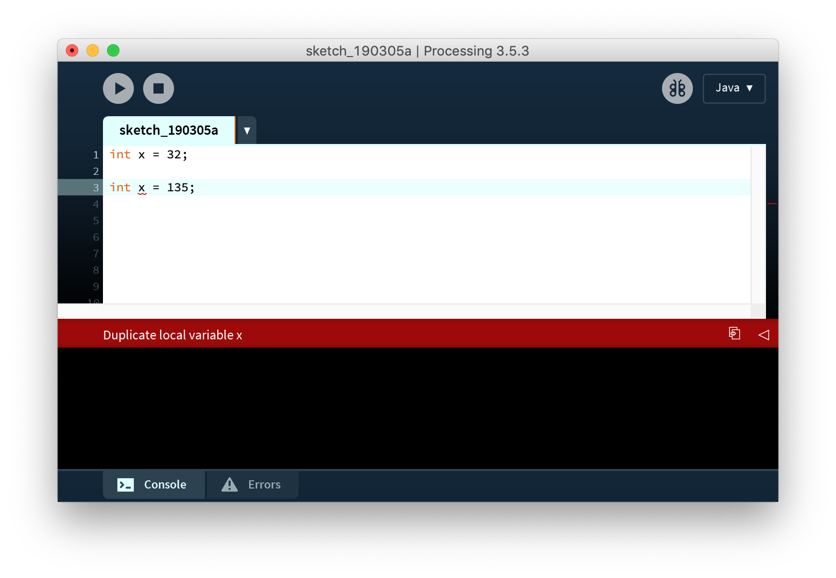
Variable Gotchas
Sometimes you will see Processing put a squiggly underline beneath a variable in red. A message at the bottom of the window will say:
Duplicate local variable x
This is an error! Processing is pointing out that you have created a variable, and then try to create a second variable with the same name.
You may have pasted some code twice - check to see if you have accidentally done this
Decide on a new name for the variable

Slide 14
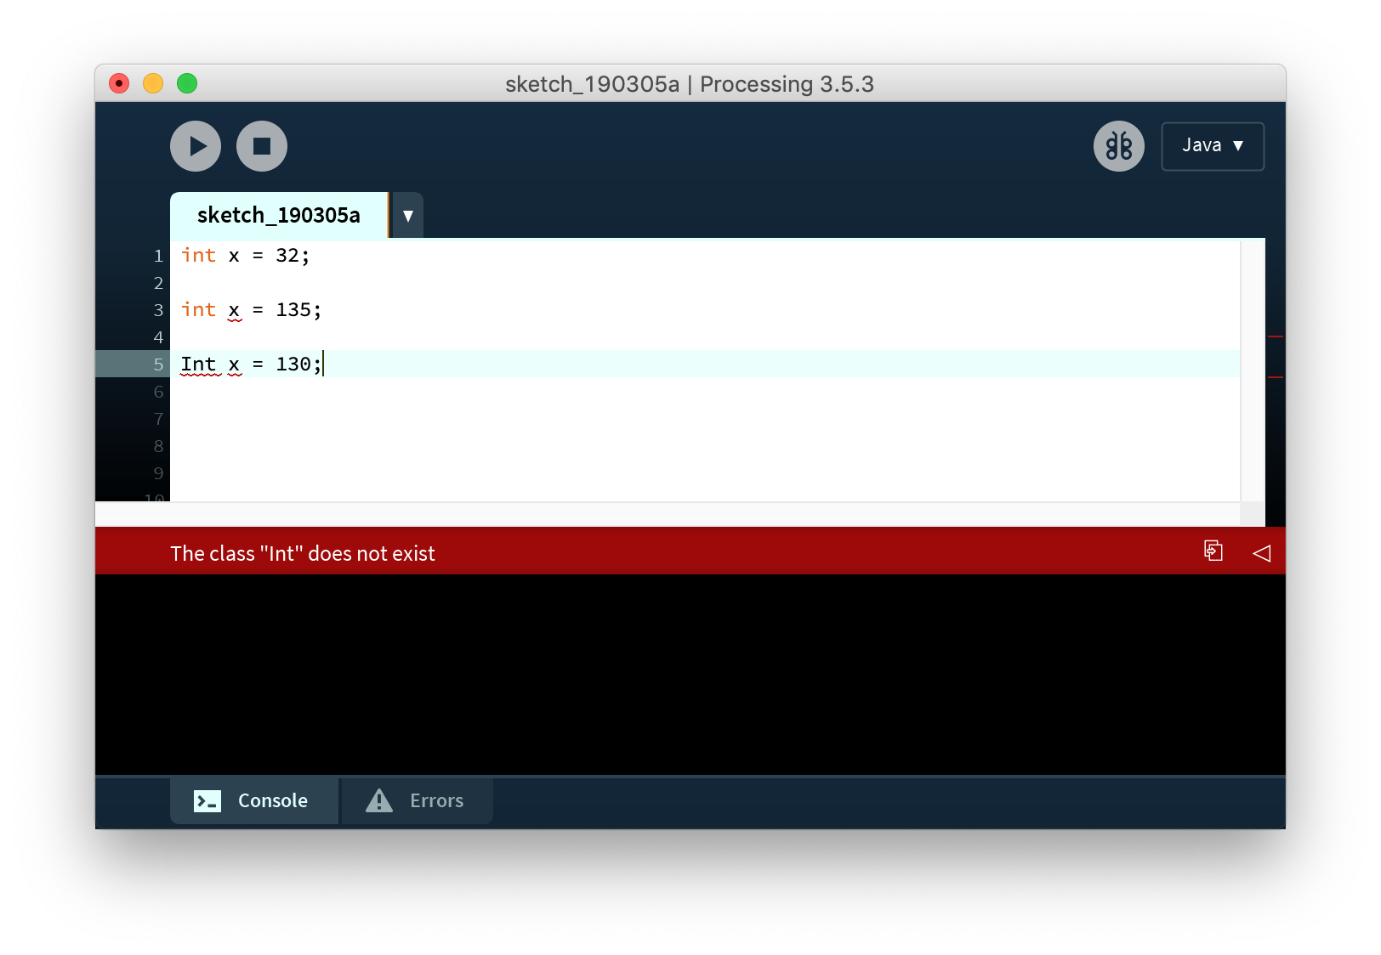
Variable Gotchas
Sometimes you will see Processing put a squiggly underline beneath the data type and variable in red. A message at the bottom of the window will say:
The class “Int” does not exist
This is an error! Processing is case-sensitive.
Check the capitalisation on “int” - it should always be in lower case.

Slide 15

RGB Colour
Computers represent colour as a proportion of red, green and blue.
All other colours can be created by blending RGB values.
Each colour is represented as a number from 0 (none of that colour) to 255 (full intensity).

Slide 16
RGB Colour
Black is no color (0, 0, 0)
Greys are balanced values of RGB colours i.e. (128, 128, 128)
White is all of the colours (255, 255, 255)

Slide 17
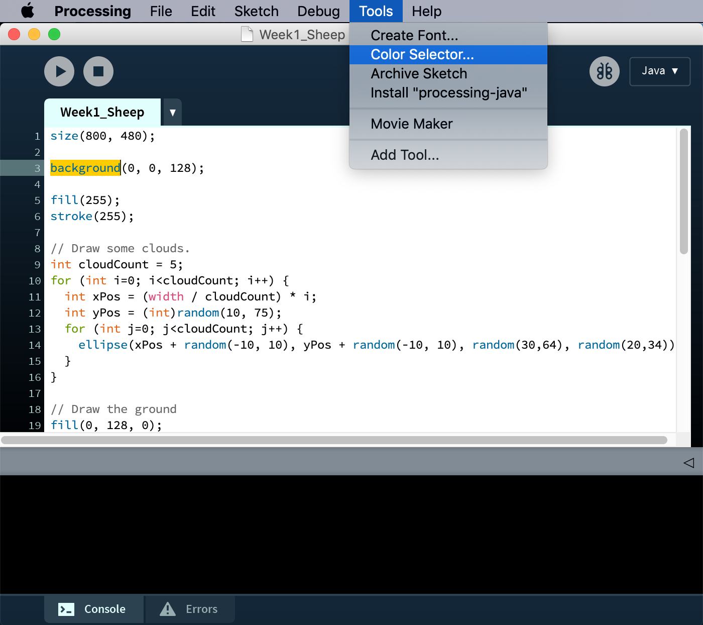
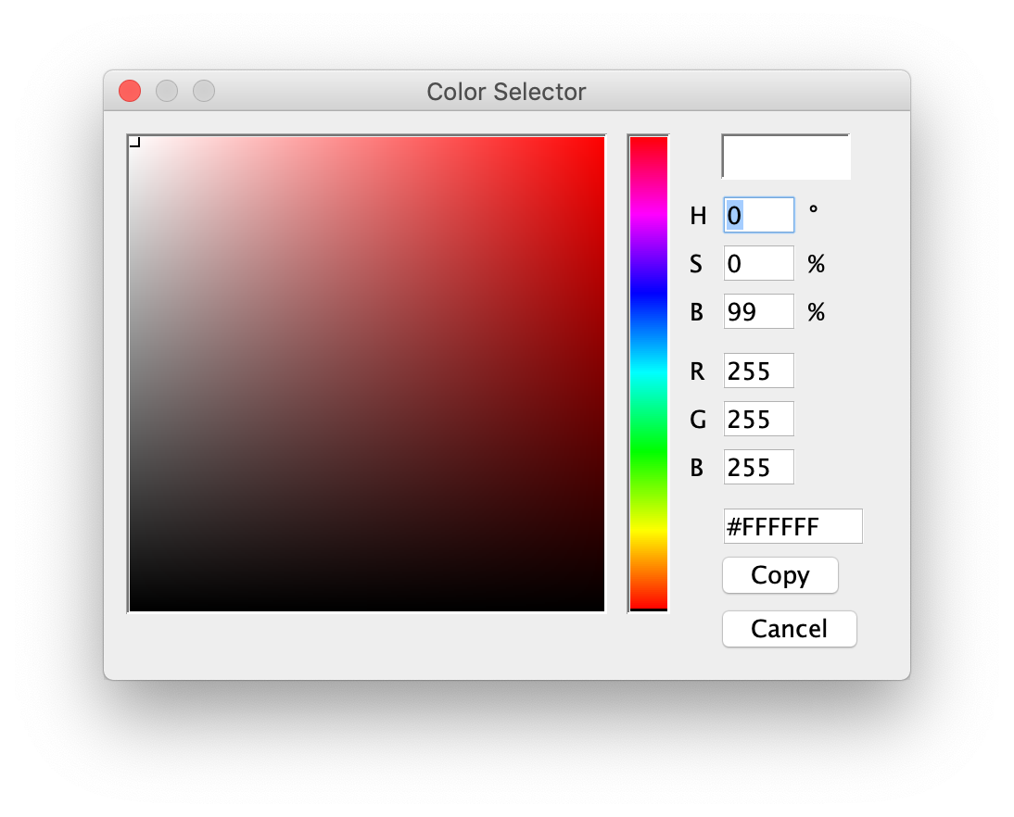
Colour Picker
Trying to guess a colour is hard. That’s why there are tools to help with this.
In Processing go to the ‘Tools’ menu then choose ‘Color Selector…’
Once you find the colour you want, read the R G and B values ready to put into your code.

